Slide 1
Disney Data Analysis
Ellie Burton, Bailey Liddle, Blake Yuenger, Will Mulhern

Slide 2
Motivation
“Whenever I wait in lines at Disney it makes me sad because I am not able to enjoy as many rides”
—Will
“I am much too impatient to wait in lines, especially when I could be riding roller coasters”
—Ellie
“I hate waiting.”
—Bailey
“Lines are such a bummer.”
—Blake

Slide 3
Why Wait Time Matters
Stoppages
FastPass
Rising Cost
Average monthly ride stoppages +42% at Walt Disney World from 2018 to 2022 (Wall Street Journal).
Disney retired FastPasses in 2021, now $15 per person for similar perks (NYT).
Guests continually have to pay for more add-ons that used to be included in ticket price (NYT).

Slide 4
Research Questions
01
02
03
04
How much does a holiday impact that day and surrounding days’ wait times?
How did COVID affect wait times?
What is the ideal month, day of the week, and day of the year for each park based on historical wait times data?
Are there any strong correlations between the weather, hours of the parks, or other variables available in the data and wait time?

Slide 5
Data Source
16 data sources from touringplans.com—1 meta data source and 15 attraction-specific datasets
Meta data has daily entries over 7 years with information about the Disney parks on that day
Individual datasets have entries every few minutes over same period—date and time and posted wait time
Final data set had 27,041 entries
"metadata.csv", Disney World Ride Wait Time Datasets, TouringPlans.com, June 2018, https://www.touringplans.com/walt-disney-world/crowd-calendar/#DataSets, Accessed 21 June 2018.

Slide 6
Data Source
Magic Kingdom | Seven Dwarfs Mine Train | Big Thunder Mountain | Peter Pan’s Flight | Space Mountain | Splash Mountain
Animal Kingdom | Avatar Flight of Passage | DINOSAUR | Expedition Everest | Kilimanjaro Safaris
Hollywood Studios | Alien Swirling Saucers | Rock N Roller Coaster | Slinky Dog Dash | Toy Story Mania
Epcot | Soarin’ | Spaceship Earth

Slide 7
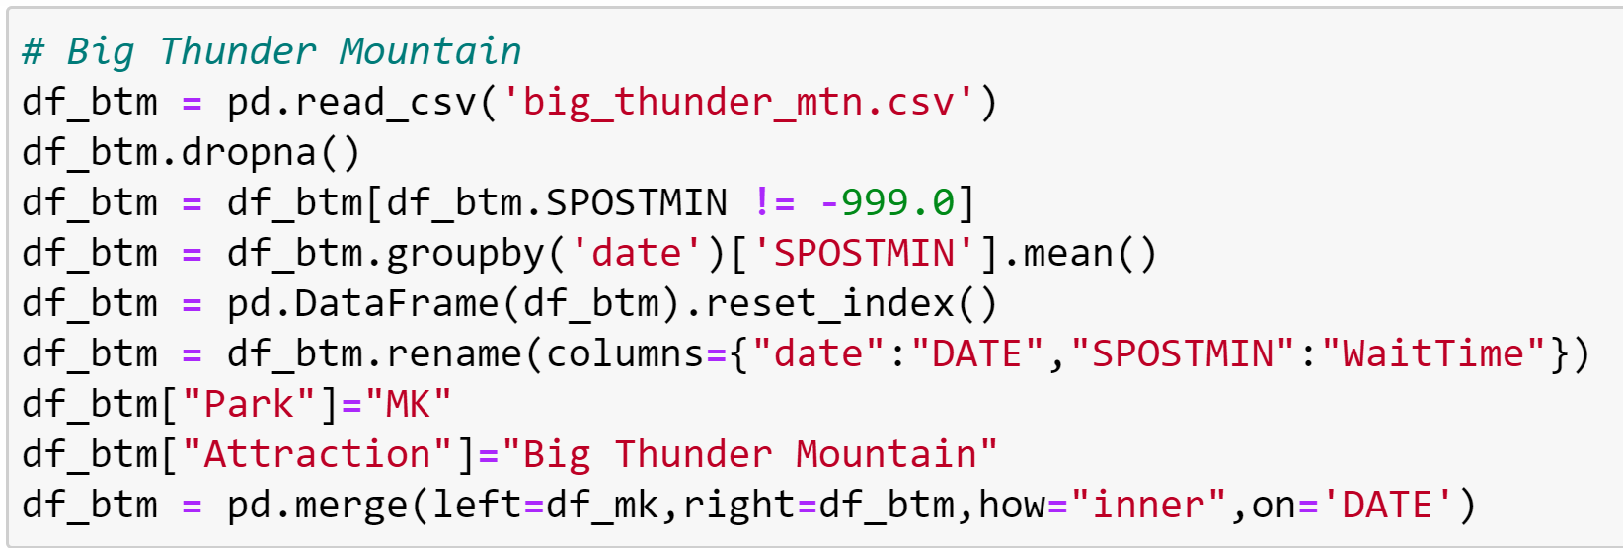
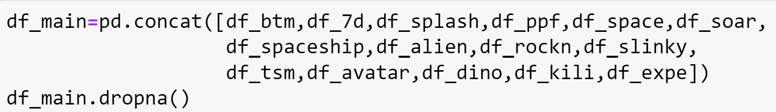
Preparing data
x15
Cleaning individual attraction data:
Resulting Data Set:
Columns:
Date
Day of week
Day of year
Week of year
Month of year
Holiday metric
Daily mean temperature
Daily inches of precipitation
Hours each park was open
Average daily wait time
Park
Attraction
Concatenating into main data frame:
Notes:
7

Slide 8
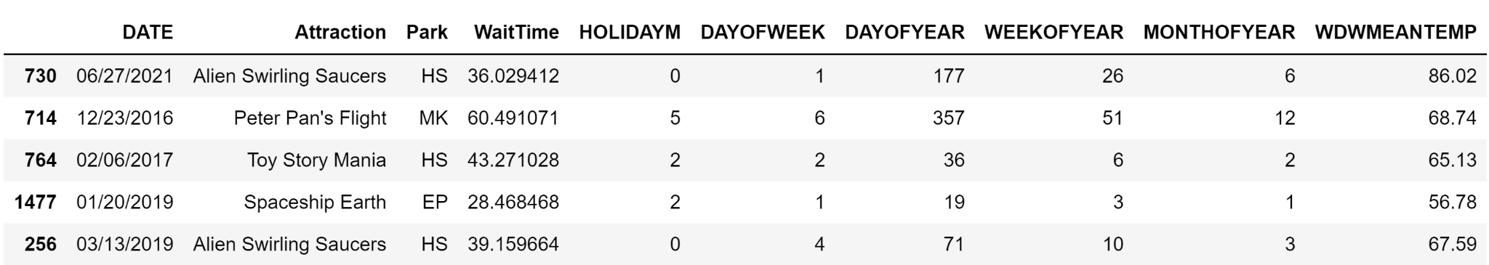
Preparing data
Cleaning individual attraction data:
Resulting Data Set:
Columns:
Date
Day of week
Day of year
Week of year
Month of year
Holiday metric
Daily mean temperature
Daily inches of precipitation
Hours each park was open
Average daily wait time
Park
Attraction
Concatenating into main data frame:

Slide 9
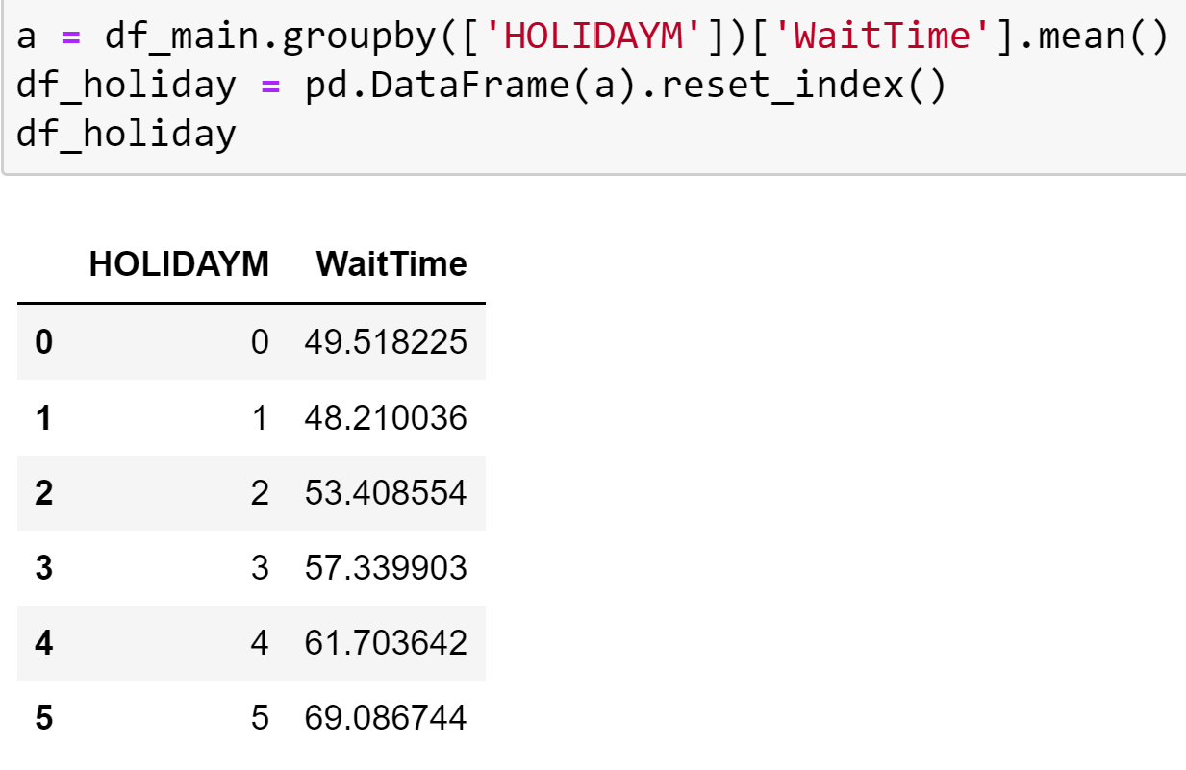
Question 1: Holiday Metric
Grouped data by holiday metric category and calculated average wait time

Slide 10
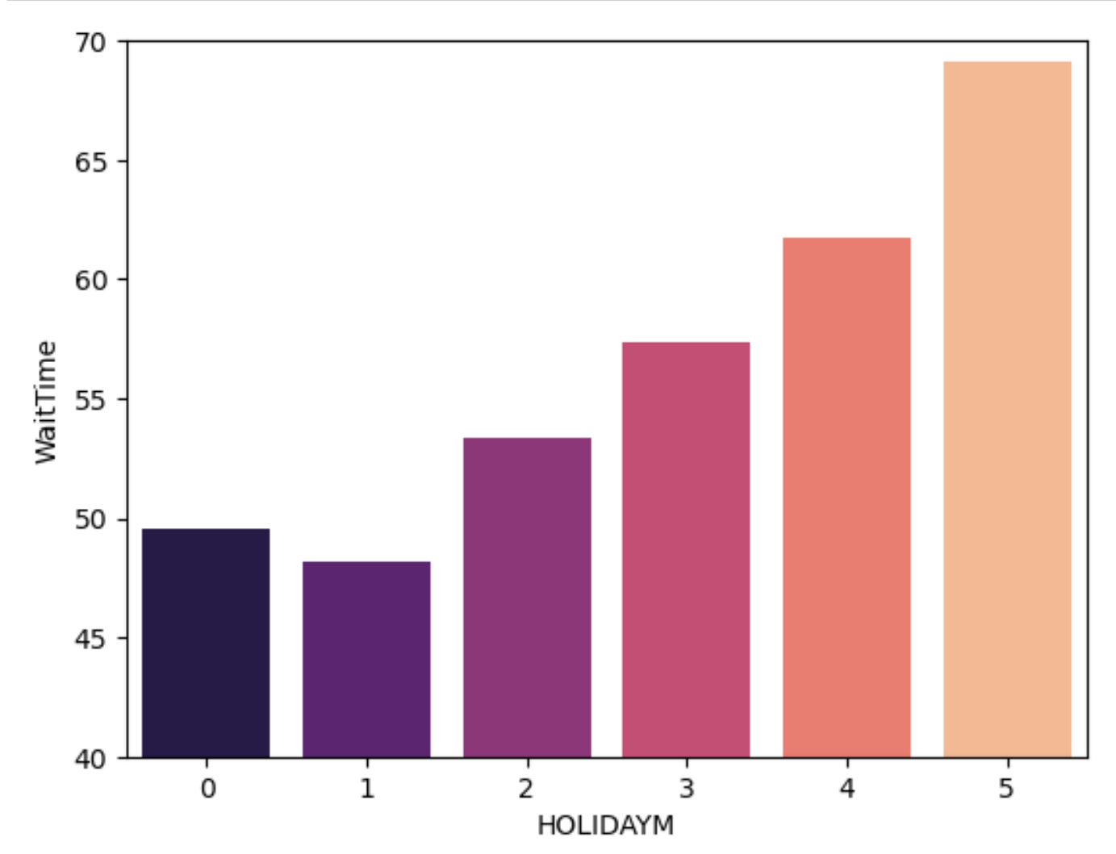
Question 1: Holiday Metric
Grouped data by holiday metric category and calculated average wait time
Notes:
Ellie

Slide 11
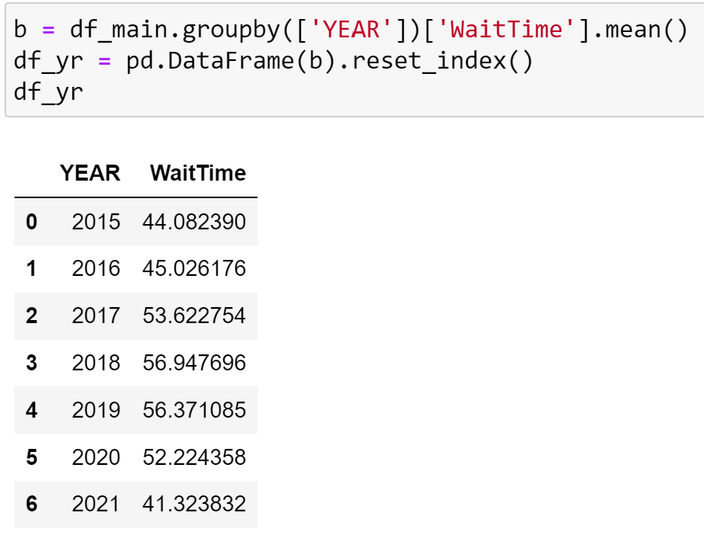
Question 2: COVID
Grouped data by year and calculated average wait time

Slide 12
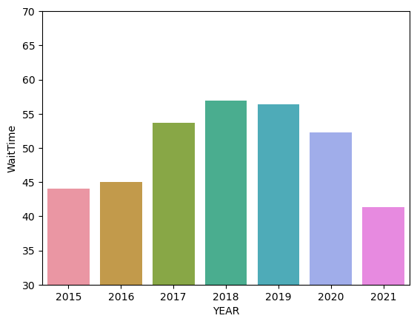
Question 2: COVID
Grouped data by year and calculated average wait time

Slide 13
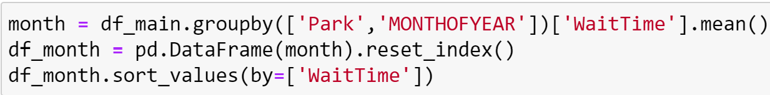
Question 3: Optimal Days
Grouped data by month, day of week, and day of year then calculated average wait time

Slide 14
Question 3: Optimal Days
Magic Kingdom | Animal Kingdom | Epcot | Hollywood Studios
September
Sunday | Wednesday | Thursday | Wednesday
September 8th | September 10th | September 8th | August 30th
MONTH
DAY OF WK
DAY OF YR

Slide 15
Question 3 Ext: Worst Days
Magic Kingdom | Animal Kingdom | Epcot | Hollywood Studios
March | February | December | March
Saturday |  |  | Monday
Dec 30 | Dec 29 | Dec 30 | Dec 28
MONTH
DAY OF WK
DAY OF YR

Slide 16
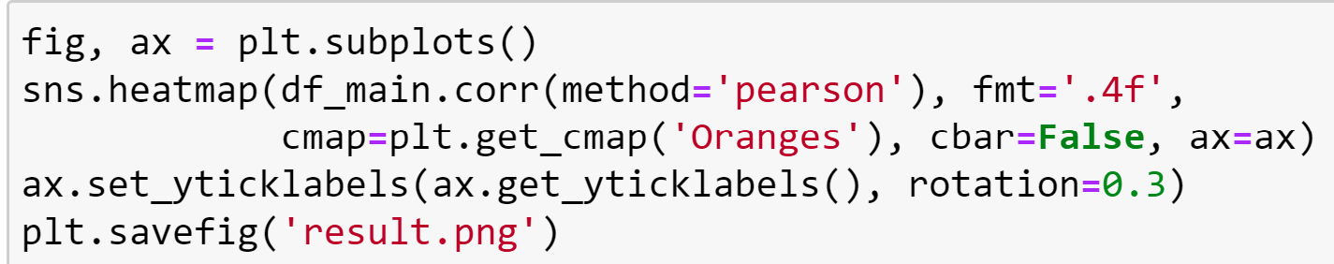
Question 4: Correlations
Between columns:
Date
Day of week
Day of year
Week of year
Month of year
Holiday metric
Daily mean temperature
Daily inches of precipitation
Hours each park was open
Average daily wait time
Park
Attraction
Notes:
BLAKE

Slide 17
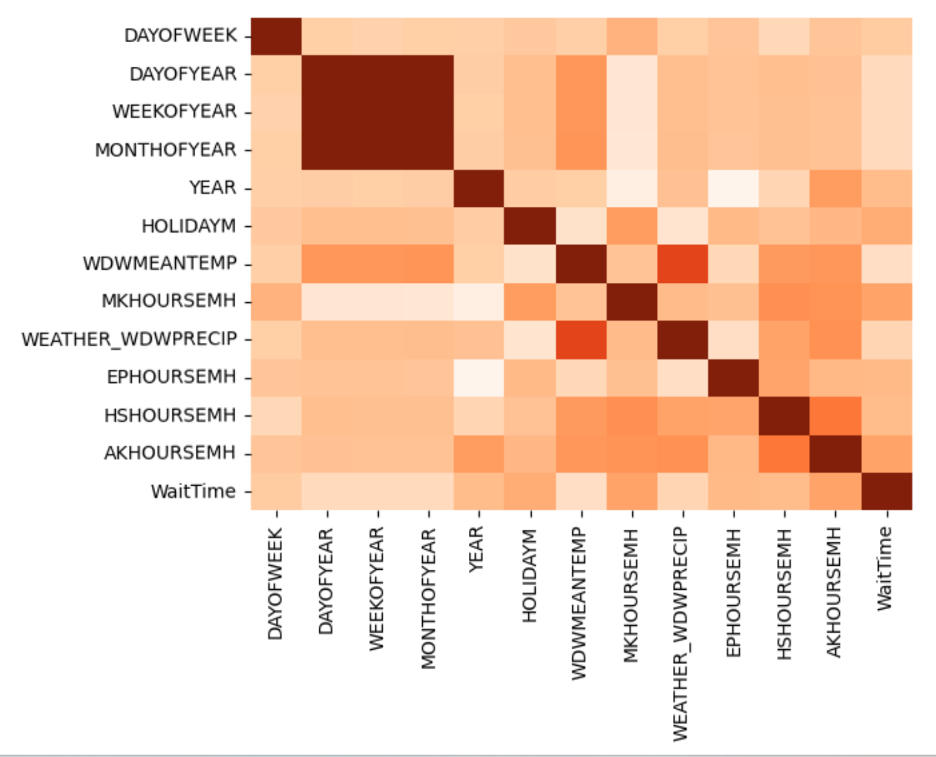
Question 4: Correlations
Between columns:
Date
Day of week
Day of year
Week of year
Month of year
Holiday metric
Daily mean temperature
Daily inches of precipitation
Hours each park was open
Average daily wait time
Park
Attraction

Slide 18
Main Takeaways
Q1
Q3
Holidays have large impact on wait times.
The optimal time to visit Disney is early September
Q2
Q4
COVID didn’t change wait times much.
No major correlations in variables to wait times.

Slide 19
Citations
https://www.wsj.com/articles/disney-parks-ride-stoppages-and-wait-times-grow-as-ticket-prices-rise-11668833084
https://www.nytimes.com/2021/08/18/business/disney-fastpass-genie-plus.html

